Slide 1
Algorithms
Lecture 7
Count Sort & Heap Sort
Prantik Paul [PNP]
Lecturer
Department of Computer Science and Engineering
BRAC University

Slide 2
Count Sort
CountSort(array, size)
max <- find largest element in array
initialize count array with all zeros
for j <- 0 to size
find the total count of each unique element and
store the count at jth index in count array
for i <- 1 to max
find the cumulative sum and store it in count array itself
for j <- size down to 1
restore the elements to array
decrease count of each element restored by 1

Slide 3
Count Sort
4 | 2 | 2 | 8 | 3 | 3 | 1

Slide 4
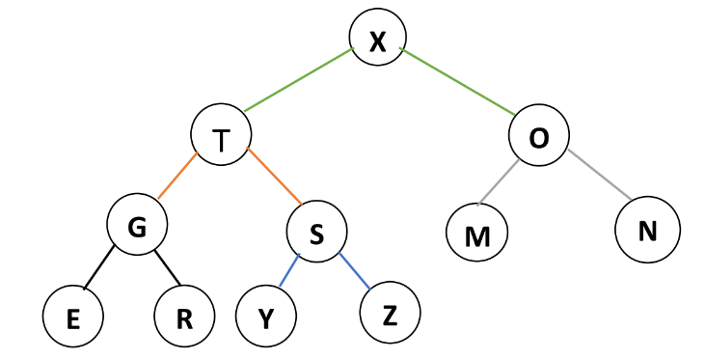



Heap - Special Binary Tree

Slide 5
Heap - Properties
→ Complete
→ Satisfy Heap Property
→ Value of Parent >= Value of Children MaxHeap
→ Value of Parent <= Value of Children MinHeap

Slide 6
Heap - Representation

Slide 7
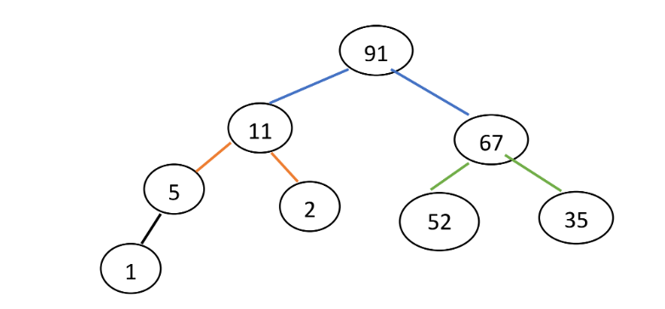
Heap - Insert
Insert 3

Slide 8
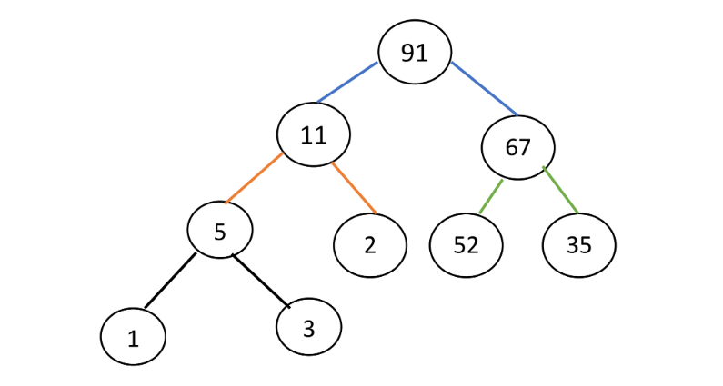
Heap - Insert
Insert 3

Slide 9
Heap - Insert
Insert 102

Slide 10
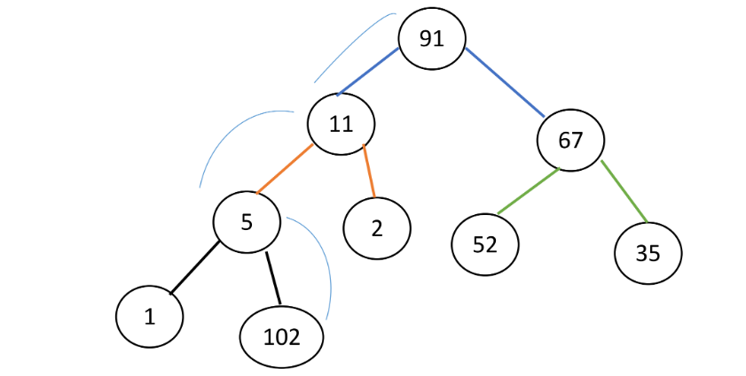
Heap - Insert
Insert 102
Swim()
HeapIncreaseKey()

Slide 11
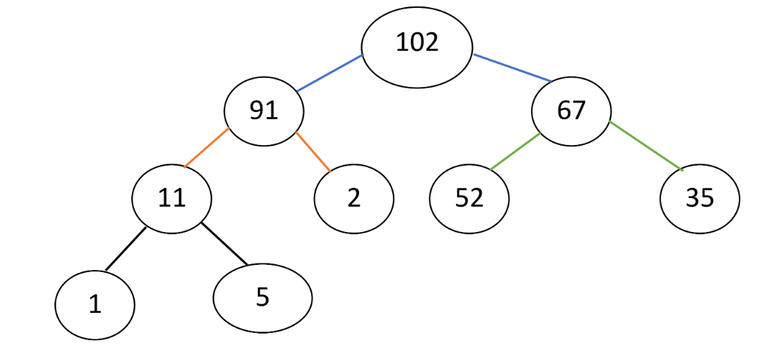
Heap - Insert
Insert 102

Slide 12
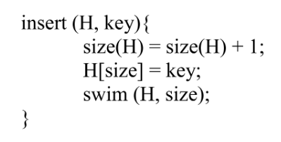
Heap - Insert (Pseudocode)

Slide 13
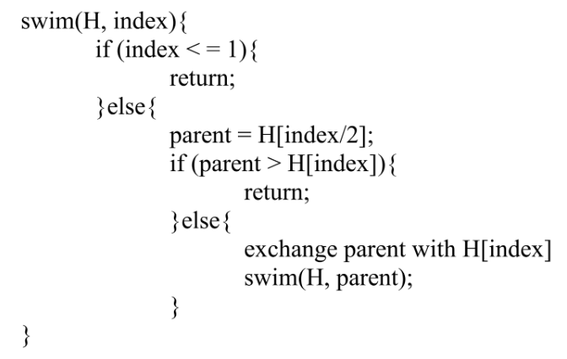
Heap - Swim (Pseudocode)

Slide 14
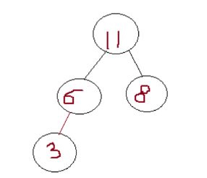
Heap - Delete
Delete Root

Slide 15
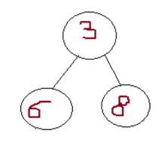
Heap - Delete
Delete Root

Slide 16
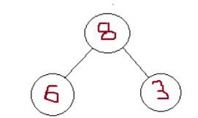
Heap - Delete
Delete Root
Sink()
MaxHeapify()

Slide 17
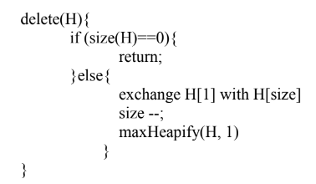
Heap - Delete (Pseudocode)

Slide 18
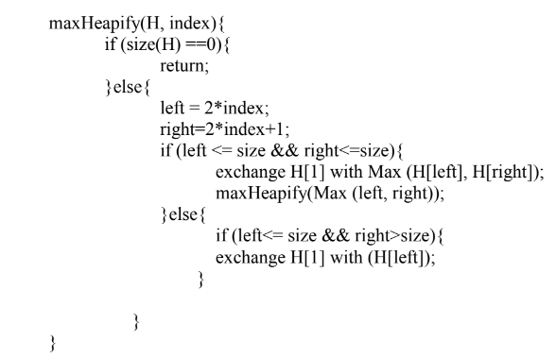
Heap - Sink (Pseudocode)

Slide 19
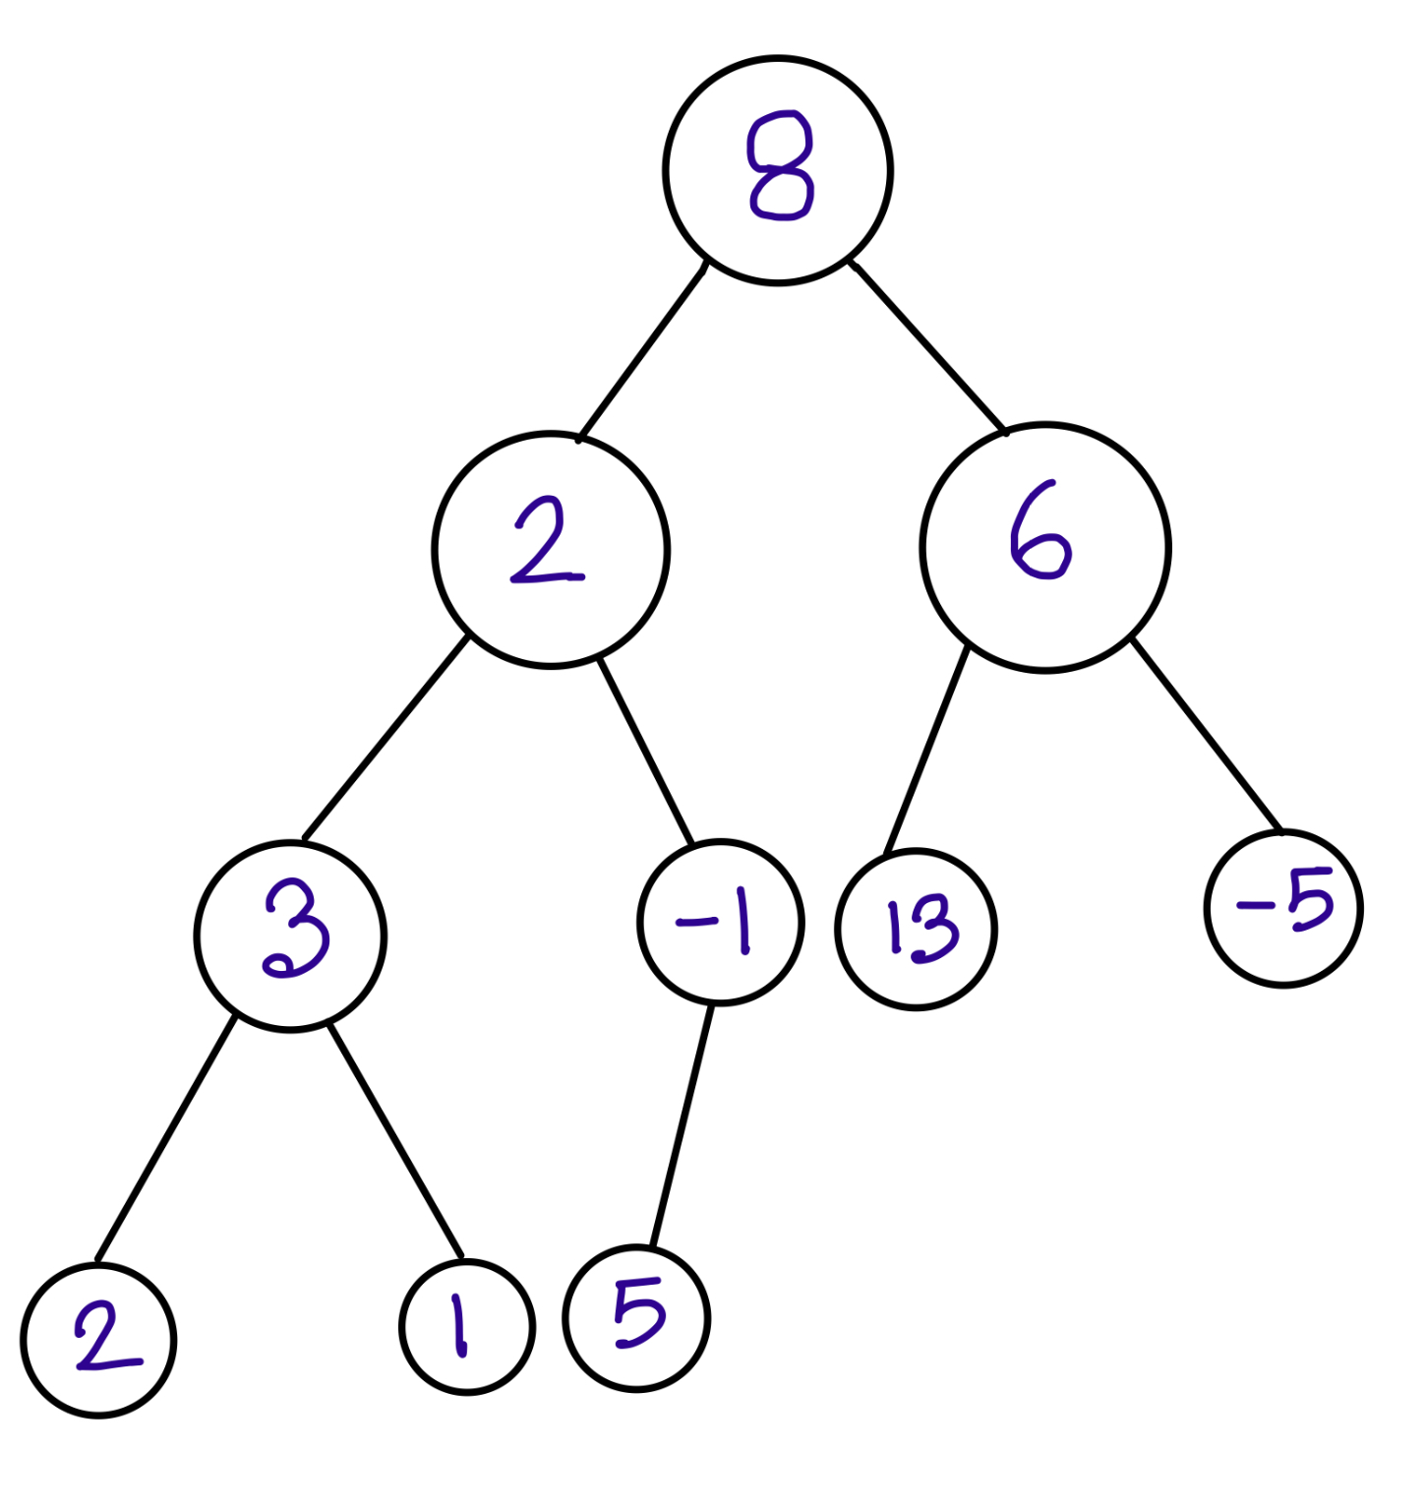
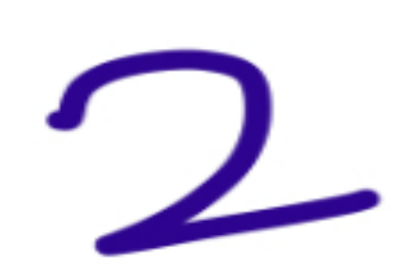
Heap - Build Heap
N | 8 | 2 | 6 | 2 | -1 | 13 | -5 | 2 | 1 | 5
Tree

Slide 20
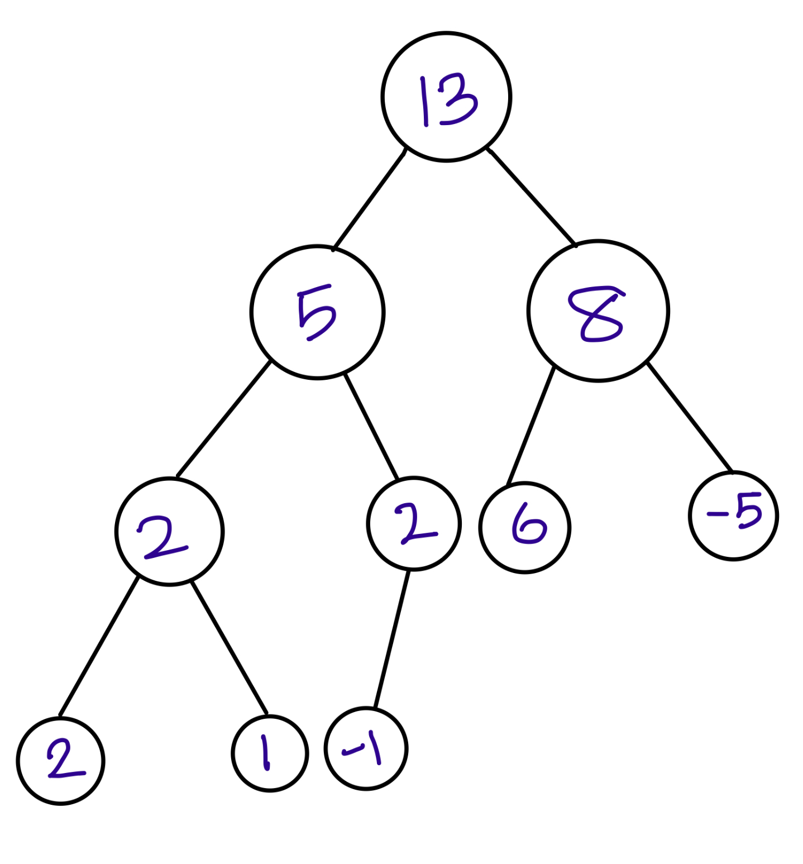
Heap - Build Heap
N | 8 | 2 | 6 | 2 | -1 | 13 | -5 | 2 | 1 | 5
for all nodes i = n/2 to 1
maxHeapfify(H, i)
Heap

Slide 21
Heap - Build Heap
N | 13 | 5 | 8 | 2 | 2 | 6 | -5 | 2 | 1 | -1
for all nodes i = n/2 to 1
maxHeapfify(H, i)
Heap

Slide 22
Heap Sort
Delete All Nodes One by one
N | 13 | 5 | 8 | 2 | 2 | 6 | -5 | 2 | 1 | -1

